Slide 1
Integrating Central and Distributed IT Groups
Simon Sharpe
University of Calgary
ssharpe@ucalgary.ca
Notes:
Last year, my director was seconded to another project and I was acting on his behalf. We were in the midst of our Integrated Service Delivery Project . My new role running Client Services had, mostly, kept me busy enough that my involvement and knowledge of our Integrated Service Delivery Project was limited.
One day, at the Director’s meeting, we were talking about something called “Transition” and how were we ever going to get it done. One of the directors said we would need somebody with strong relationship skills, good organization, and an ability to move projects along. She then said, “Simon would be good for the role.” I need to tell you, it was a beautifully laid trap. Instead of saying “Hang on a minute, exactly what would I be accountable for delivering?” I was still glowing from the compliments and said,” Gosh, sure, I could do that.”
Sometimes you don’t have to be the best PM to be given a project, just the most gullible person at the table.

Slide 2
Overview
Background
What the initiative is
Why we are doing it
How we are doing it
Obstacles
Circumventing obstacles
Conclusions
Questions
Notes:
BG: Me and the organization
What: Scope: My piece is part of a bigger project
Timing: My piece is the beginning of a longer process
Why: what concrete results are we after
How: there are a lot of different ways of breaking this down into pieces
Obstacles: I knew it was going to be hard but I didn’t know how hard. The fact that they went to the trouble of tricking me into it should have been a clue
Circumvent: We don’t have a perfect plan to get by every obstacle, but we’ve learned some things that work and don’t work.
Conclusions: What I want you to remember when you get back to work
Questions:

Slide 3
My Background
I’ve worked in industry and Higher Ed
I’ve been doing IT at University of Calgary for 11 years
I've taught as a sessional instructor
I’ve worked in faculty IT and central IT
I’ve worked as IT liaison with the Business School
I’ve spent most of my time in Client Services
I am the ITIL guy
I am gullible
Notes:
I’ve been around
I know the business of the Faculties
I know the business of faculty IT
I’ve had a lot of customer contact
I understand IT Service Management, and you will see why it matters for this initiative

Slide 4
Integration Background
We’ve been centralizing services, in a quiet way, for years
Replacing the business school’s email service with the central one
Working out agreements with faculties to take care of their labs
Bringing faculty IT service desks in
Increasing the % of workstations that are centrally supported
Sharing positions with faculties
Notes:
The fact is, you have faculties who are doing things out there that they would dearly like to be rid of, like running their own email services (spam, accounts, passwords, etc.), running their own file services (backup and recovery, security, availability), or running their own server rooms (late-night phone calls).
We’ve been doing it, not as part of some large project, but as incremental improvements. You don’t need a large, formal initiative.
It is just good business. These small, front-line agreements have delivered a lot of value for us and helped build trust. We’ll talk more about trust later

Slide 5
What the Initiative is
Integrated Service Delivery
IT, Finance, and HR
A new org chart
Central IT accountable for more services
Faculty IT people will report to Central IT
New Partner roles
Notes:
Which units are running their own service units?
What is a “service unit”
That word “accountable” is an important one here. We don’t want to say we are “taking over faculty IT” we want to say we are “accepting accountability for their services”
We make some very detailed agreements and note existing deficiencies

Slide 6
The “Not an org chart”
CIO
University of Calgary
ISD IT Client
Relationship
Management
Application Services
Infrastructure Services
Information Security & Compliance
Office of CIO
ISD IT Partners
Solutions/
Business Analysis
Problem & Change
Security Arch
Strategic Plan
Client Services
Monitoring & Reporting
Client Partners
Regulatory & Audit Compliance
Strategy
Consulting Services
Applications Development
Help Desk
Portfolio Mgmt
Research Consulting Services
Access Control
IT Service Delivery
ERP
Desk Side, Labs & Print
Disaster Recovery
Other Platforms
Com/Media
Service Del’v
Solutions Implementation & Planning
Maintenance/Hosting
Access Provisioning
Project Mgmt
Solutions Implementation Coordination
Software Release Mgmt
Infra Sol’n Engineering
Service Delivery Methods
Data Management
Benchmarking
Training
Server
IT Vendor Mgmt
Communications
Storage
Quality Assurance
Network (V&D)
IT Enterprise Architecture
End User Platforms
Audio Visual
EA
Service Operations
Bus & Research Solutions
Budget & Asset Mgmt
Facilities
HR
Notes:
From IBMs component business model
One new role that is central to our transition is the IT Partner Role. We have 10 people designated as IT Partners
Client Services folded into infrastructure
Separate role for infrastructure solutions engineering
New separate QA role
Dotted lines
Where does each distributed IT person belong?

Slide 7
Why we are doing it
We think that integrating common functions, like;
supporting desktops or labs
managing applications
running infrastructure
…under a single service owner will help us with;
economies of scale
standardization of tools and processes
Risk Management
IT Service Management
Getting people doing more of what they are good at
Notes:
There are people out there in the faculties that think they are doing IT better than you.
Some of them are probably right

Slide 8
How we are doing it
We could go;
Faculty by faculty
Service by Service
We could define boundaries by;
Person
Service
Either way, there are going to be loose ends
Notes:
We decided to go faculty by faculty so that we could work out one agreement with each Dean and we could not have to keep going back to that dean.
Not only are some people split between Base & Supplemental and other IT Services, some are split between IT Services and non-IT services
There would also have been advantages in going service-by-service because we could choose to start with some of the larger services that everybody agrees are “commodity services”
We have a pretty good Service Catalogue, which defines certain services as “Base” or “Supplemental” – these are all free
Examples are email, Web Content Management Consulting, etc.
Other services

Slide 9
Steps to transition faculty
Preliminary Assessment
Ensure the Dean and CIO are ok with our direction
Permission to collect more data
Detailed agreement
Services
Names, inclusions/exclusions, service levels, deltas from standard IT services
People
Titles, activities, connection to services
Inventory
Machines, software, tools etc.
Notes:
We had a case where our CIO met with a Dean and they had different understandings of what was and was-not in-scope.

Slide 10
What is in and what is out
Services
Services in the categories of Base or Supplemental in the Service Catalogue will become IT’s accountability
People
Distributed IT people who are spending more than half of their time delivering Base or Supplemental services will report to IT
Sounds great in principle but is just a starting point
The scope of transition for each faculty needs to be negotiated then agreed between each Dean and the CIO
Notes:
We have a pretty good Service Catalogue, which defines certain services as “Base” or “Supplemental” – these are all free
Examples are email, Web Content Management Consulting, etc
Other services
The agreement should be pretty close to “done” when it gets to the Dean/CIO

Slide 11
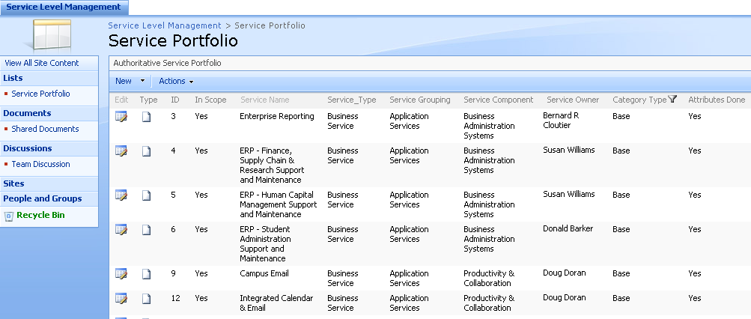
Service Catalogue
Notes:
Service name, Category, Owner

Slide 12
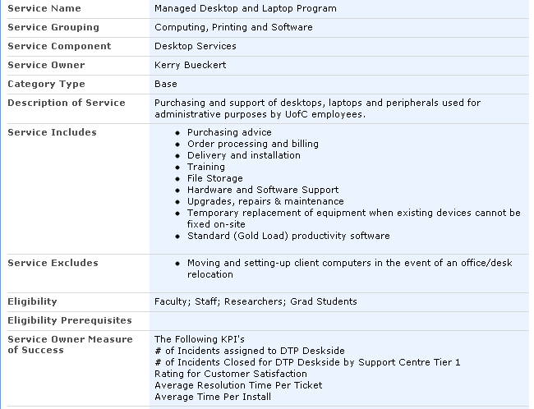
Service Attributes
Notes:
We do not have full Service Level Agreements for each service.
We think of these Attribute worksheets as the outline of the SLA.

Slide 13
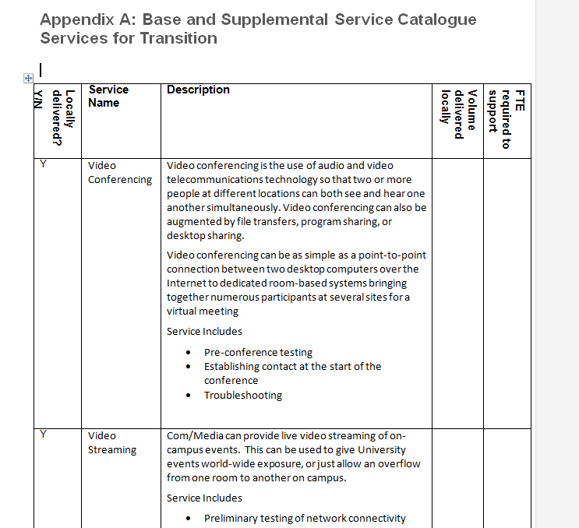
The agreement: Table A
Notes:
Do you do this locally? How much of it? Service Owners need to know

Slide 14
The Overall SLA
We do intend to have SLAs for each service
Deans wanted to see “an SLA”
Incident response times
Generic availability
Hours of operation
Notes:
Do you do this locally? How much of it? Service Owners need to know

Slide 15
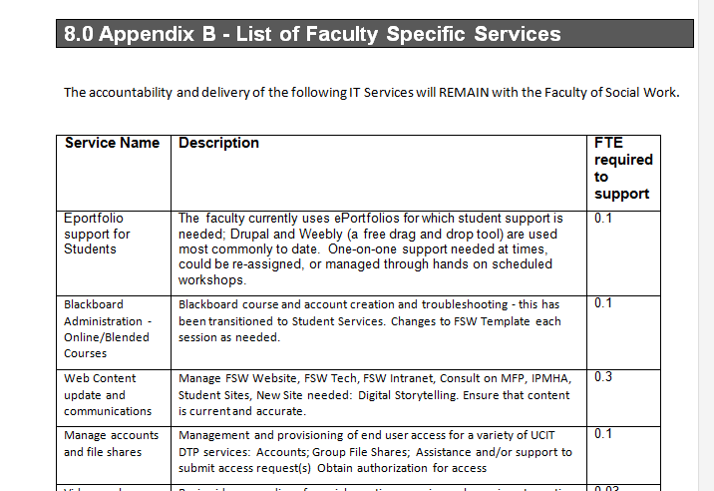
The agreement: Table A
Notes:
These are the places where IT does not add value. The computers attached to your mass spectrometer. Your patient simulator.
We do not add any value there.
Some people.
Some people lump many IT and non-IT things together into one category. The “exclusions” part of the service attributes helps identify them.

Slide 16
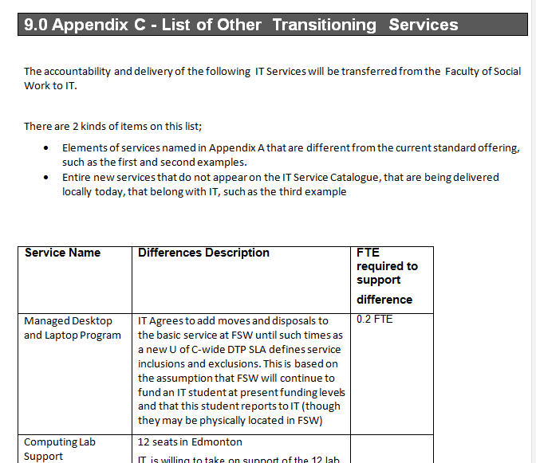
Notes:
We have the partner go back into the unit to collect this information.

Slide 17
Appendix D: Staff
Name, title, services and role
Staying with unit or transitioning to central IT
Likely destination directorate

Slide 18
Obstacles
Questions about Funding
Weak mandate
Too Little trust
Differing services
Differing roles
Differing HR classifications
No common language
Notes:
Some people from the faculties were distrustful, thinking that IT was trying to take advantage of them
Some service-owners in IT were distrustful, thinking the faculties were trying to take advantage of them
In short, it was like presiding over a shotgun wedding, with a reluctant bride, a reluctant groom, and a shotgun that everybody knew wasn’t real.

Slide 19
Obstacles
Embryonic IT governance process
Lack of understanding
New IT Leadership team
Active resistance
Passive resistance
Passive-aggressive resistance
Fear

Slide 20
Questions About Funding
We know that combining services will save the institution money, but we spent a lot of time talking about “who’s budget?”
In the first part of each transition (6 mos to 1 year) the funding for the distributed staff stays with the faculties, the reporting goes to IT
Notes:
Will we have to pay for that?

Slide 21
Weak Mandate
The Deans were not told explicitly “You have to do this.”
Deans Council is a powerful force
We need to do some selling
We need to be flexible
We need to start with the easy ones
Notes:
It may be that the President does not have (or want to expend) all their political capital on pushing this through.
Our new CIO, Vaughn Ravenscroft, who is from South Africa said “It will be like herding elephants.”
Huh?
“You can’t really make them go anywhere, but if you let some go in the direction you want them to go, the rest will follow

Slide 22
Too Little Trust
Some people in the faculties felt that IT was trying to “put one over” on them
Some people in IT felt that the faculties were trying to take advantage of them
Trust is a commodity, it can be earned and it can be spent
Know if you are already “overdrawn”
Let them know what is in it for them
Notes:
Faculties do not want to worry about critical services going down in the night, lost data, hackers breaking in etc.
Many distributed staff members are out there doing, maybe 60% of their time with applications, 20% with infrastructure, and 20% supporting desktops and smartphones. Most of them would like top specialize in what they are best at.

Slide 23
Differing Services
Our Desktop Service includes “disposals,” yours does not
Our Videoconferencing makes a technician available at session-start, yours does not
Articulate exactly what the differences are
Both sides should show some flexibility

Slide 24
Differing Roles
In IT, the DBA and the Enterprise Reporting guys are different people, in the faculty it could be the same person
Don’t try to fix it right away
After IT is accountable for the services, work can be moved as appropriate

Slide 25
Differing HR Classifications
IT Application Developers are Management and Professional staff, in the faculties, some are AUPE members
People doing similar work in different units are different job-levels and pay rates
Engage HR
Identify the issues
Don’t think you need to fix it immediately

Slide 26
No Common Language
“Managed Desktop” does not mean the same thing to me as to does to you
IT wants to frame the conversations around the Services, some smaller IT groups talk in terms of activities or even technologies
Use the Service Catalogue
Move conversations about Activites and Technologies to the Services they support

Slide 27
Embryonic Governance
IT should not be the ones deciding;
which services should be built
what are appropriate service levels
which services should be retired
which services should be base-funded
We are still Waiting For Governance
I don’t have an easy answer

Slide 28
Lack of Understanding
Or, is that “poor communication?”
Separate your project into 2 parts;
Up till the transfer of accountability for services and staff
After the transfer of accountability
Have a Communication Plan
Execute on the plan
Revisit the plan regularly
Notes:
When somebody tells me something like “Those guys don’t get it,” what I hear is “I don’t know how to communicate it.”

Slide 29
Fear
The new situation has less risk than the old
Risks are transferred from the unit to IT
Communicate well and listen well
If the faculties aren’t nervous, they might not completely understand their risk exposure

Slide 30
Your New Team Members
Opportunities to do more of what you are good at
On day one your activities and accountabilities do not change
On day one your job profile does not change
It does not necessarily mean you are moving
Your initial connection-point is not forever
You are a new team member
We need your local knowledge

Slide 31
New IT Leadership Team
Forming
Norming
Storming
Storming
Forming
Storming
….
Name a project sponsor who has the final say
Notes:
Those of you who have suffered through training on team development will be familiar with this

Slide 32
Resistance
Even “good” change is hard to sell
Get some early victories and don’t be shy about sharing them
Know who is resisting and why
Come back to what’s in it for them
Be flexible and really listen
It is like herding elephants

Slide 33
Conclusion
Trust is a commodity
Focus on the big services
Make sure everybody is speaking the same language
Don’t underestimate the value of the “quiet approach”

Slide 34
Questions

